Slide 1
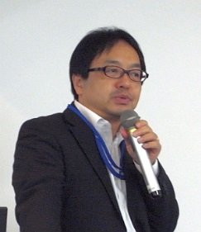
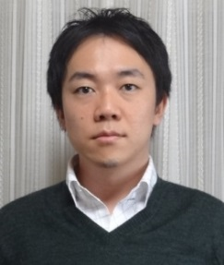
IEEE ITS Society Distinguished Lecture Series
STUDENT DAY of AUTONOMOUS DRIVING
Co-sponsored by IEEE ITSS Tokyo Chapter and Nagoya Chapter
D&T： 27 November 2014, 3:00pm-6:30pm
Venue： Hukutake Hall, The University of Tokyo
talk：
Autonomous Driving
Technologies and Challenges
Speaker: Mr. Tsuguo NOBE (Intel Japan)
Video View：
Autonomous Driving
Feel the state-of-the-art
Facilitator: Prof. Shinpei KATO (Nagoya Univ.)

